Slide 1
Shaastra – IIT M
Crayon Data Analytics Hackathon
Team Ravaangi
Vijendra Kumar Saini
Vibhaas Kotwal

Slide 2
Agenda
Problem Statement
EDA
Data Preparation
Customer Segmentation
Model
Evaluation

Slide 3
Problem Statement
The theme of the challenge is to predict the future behavior of users based on what they have done in the past.
Goal
Generate transaction for the customers based on the historical data available. Please refer
Result type 1: Customer Id, Merchant Id (Mcc_code), Frequency of transaction
Result type 2: Customer Id, Date, Merchant Id
Predict the future behavior of customers

Slide 4



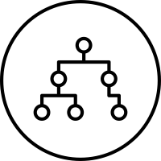



Methodology
Data Acquisition
Machine Learning
Problem
statement
Design Approach
Get Data
Transform
Business Understanding
Inference
Algorithm
evaluate
visualize
communicate
model
train
test

Slide 5
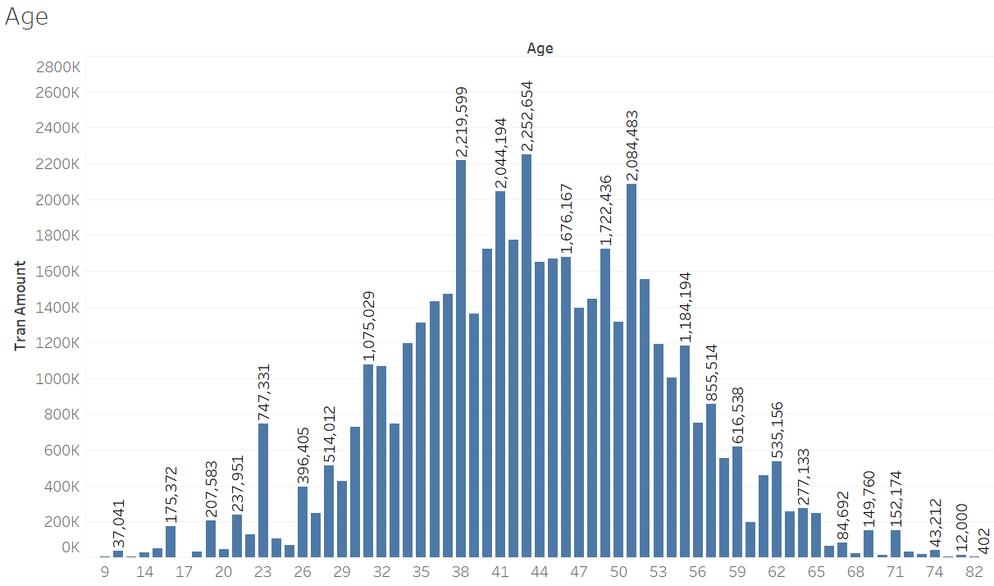
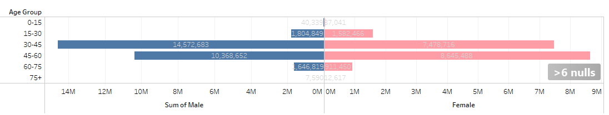
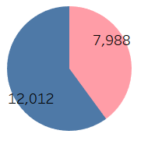
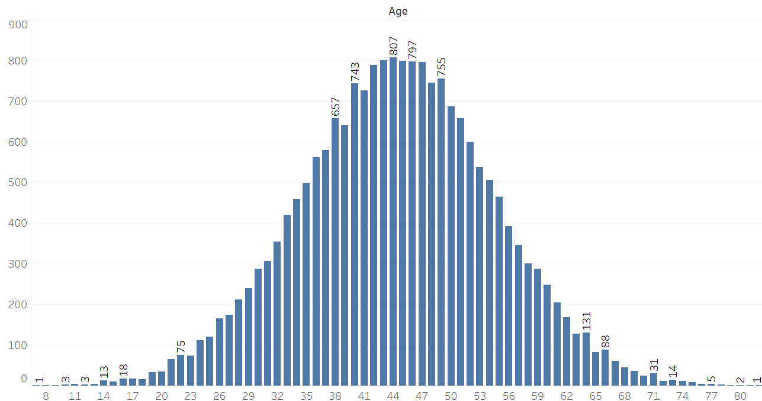
EDA insights
Male spent more than females in the age group 30-45,
but this trend changes drastically for age group 45-60 where total spent by females is very close to males in same age group
This clearly is a Normal curve
Customers between 35 and 55 years are big spenders

Slide 6
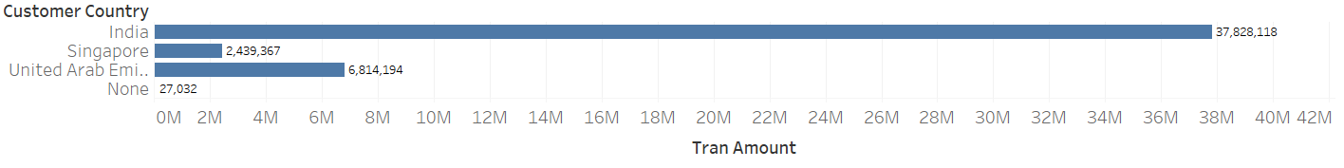
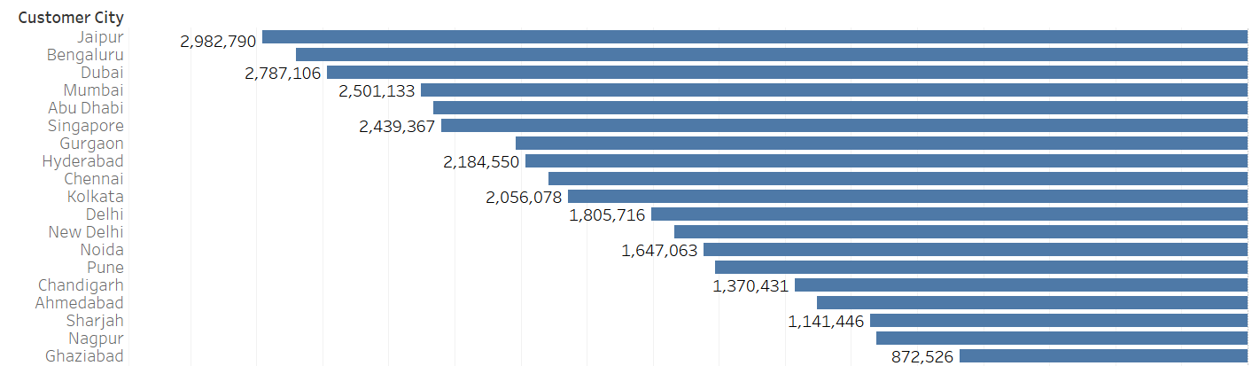
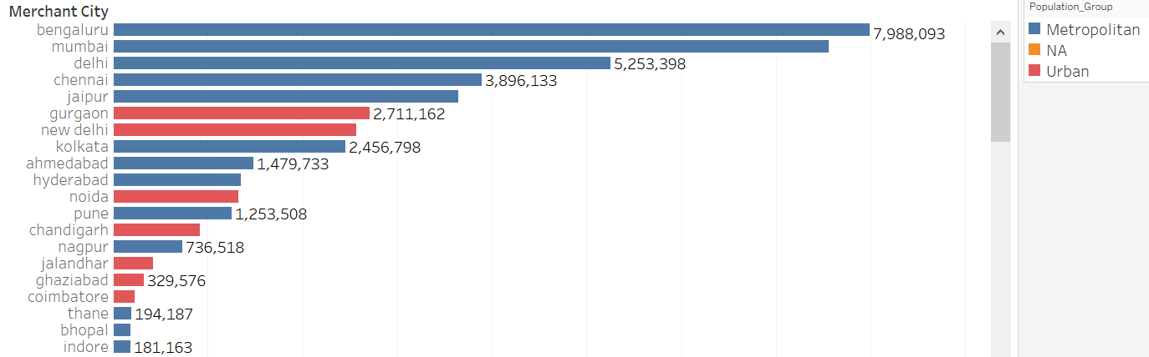
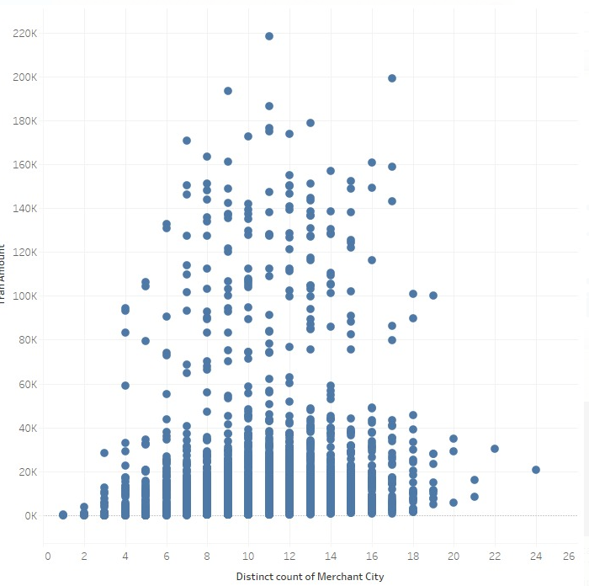
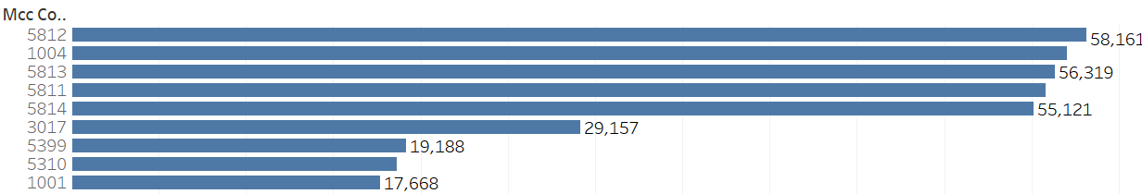
EDA insights
Customers from Jaipur are highest spenders and highest spending is in Bengaluru

Slide 7
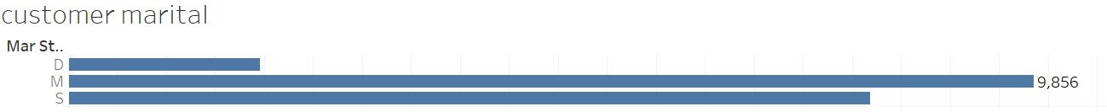
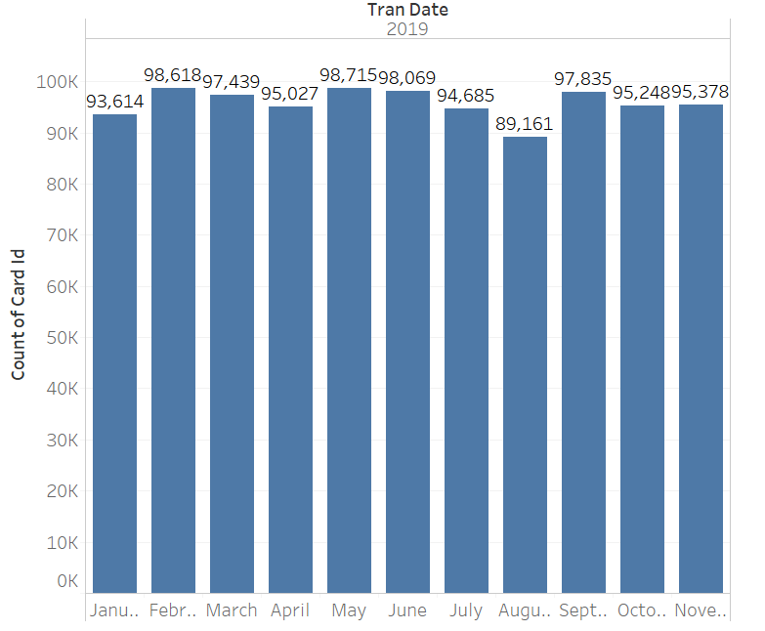
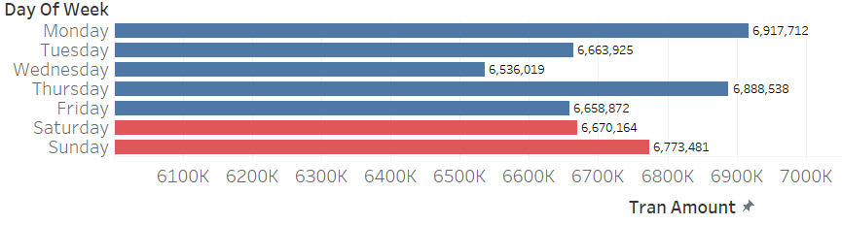
EDA insights
Married are spending highest followed by Single and then Divorced
Platinum card holders are spending most
Gross value of purchases is highest on Monday

Slide 8
EDA insights
Data Understanding
Transaction, 550,000
Customer Demographics,
10,000
transaction
customer_id | Unique customer ID
tran_id | Unique transaction ID
tran_date | Transaction Date
tran_amount | Transaction Amount
merchant_name | Merchant Name
merchant_country | Merchant Country
merchant_city | Merchant City
mcc_code | Merchant category code
card_id | Unique card ID
Transactions without customer demographics,
300,000
Customer w/o transactions,
6,000
Transactions with customer demographics,
250,000
Customer Demographics
customer_id | Unique customer ID
card_type | CardType | SILVER, GOLD, PLATINUM, WORLD
card_id | Unique card ID
mar_status | Marital Status | S, M, D
age | Customer Age
gender | Gender | M, F
customer_country | Customer Country
cr_lim_group | Credit limit
customer_city | Customer Ciy
customer_id_new | Unique customer ID
customer_uid | Unique customer ID
Categorical Features :
dummy_india
dummy_marital
dummy_gender
dummy_cardtype
dummy_crlimit
Feature Engineered
age_group
customer_city
Product Category – NA
Mer_city_grp
Cust_city_grp
Mer_state
Cust_state

Slide 9
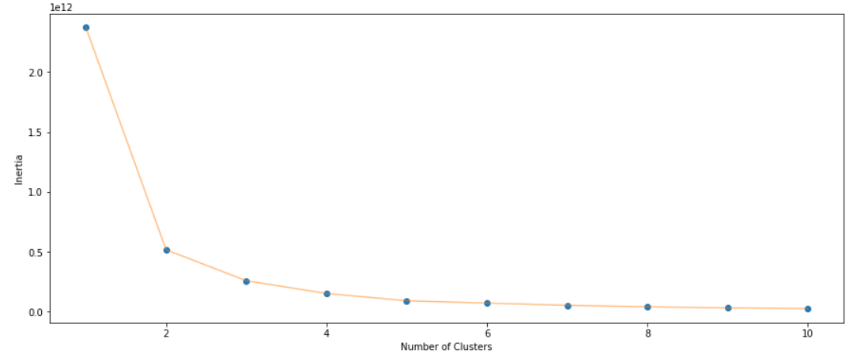
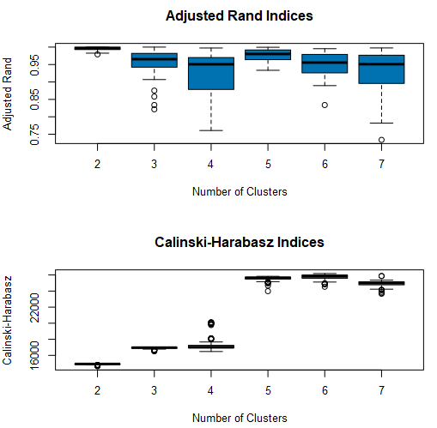
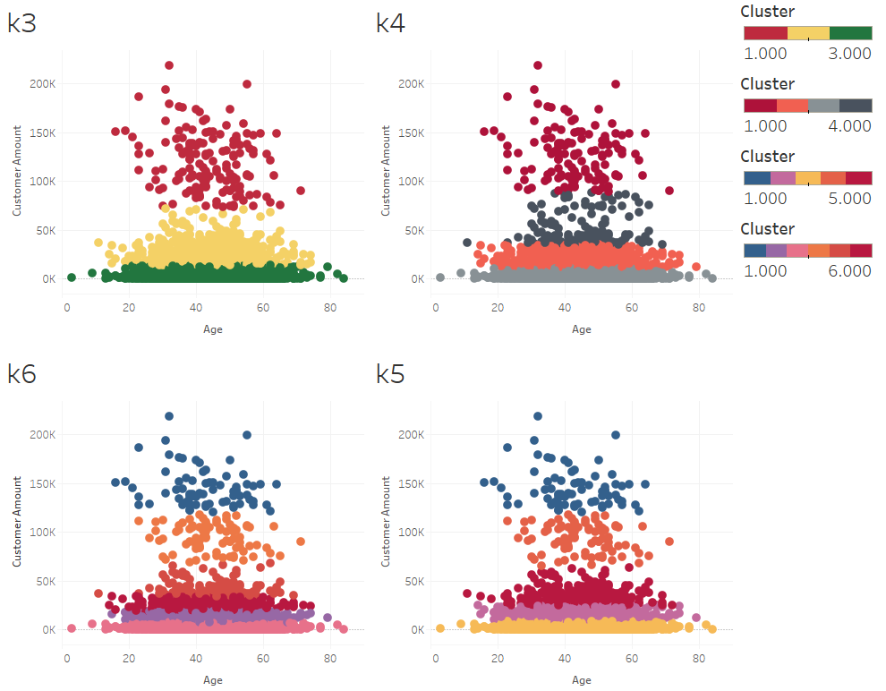
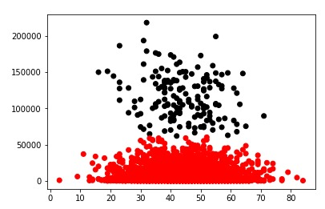
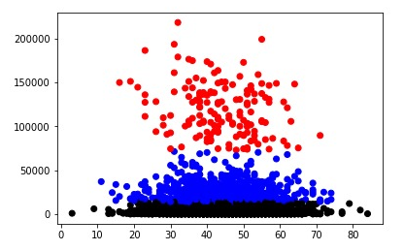
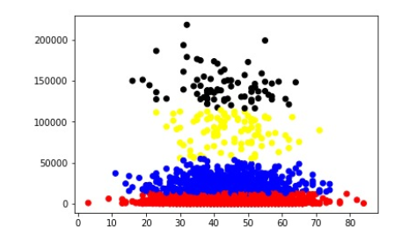
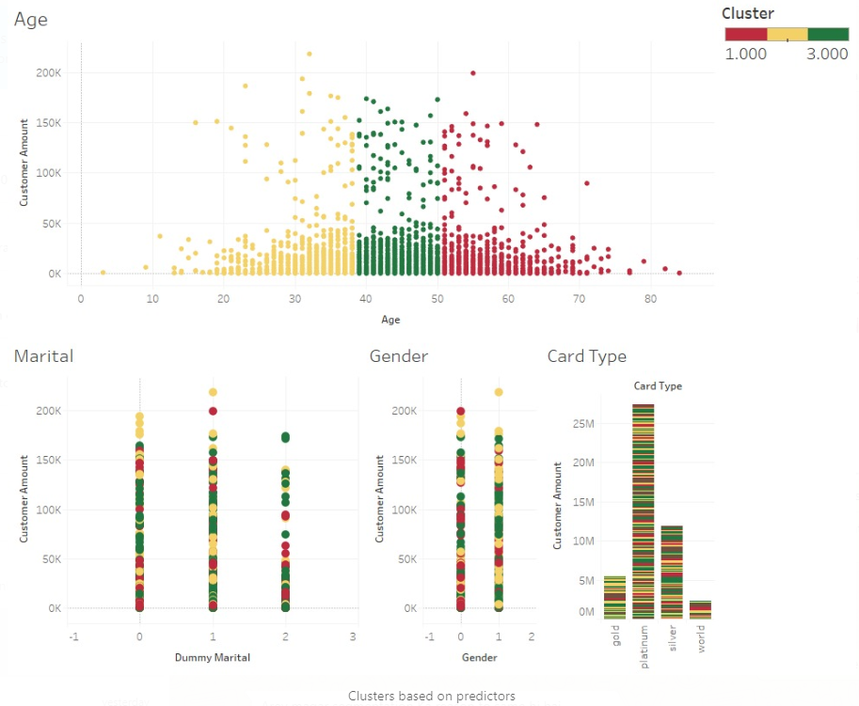
Customer Segmentation
K Means
Clusters created based on predictors
Clear classification on Age but other are all mixed.

Slide 10
Data Preparation
RFM – Recency Frequency Monetary
Next Purchase Date
7 Month Behavior Data
First purchase in next 4 months

Slide 11
Model
Binary classification
Decision Tree
Random Forest
Logistic Regression
Gaussian
KNN
Support Vector Machines
X Gradient Boosting (Best Results) 74%
Evaluation
Confusion Metric

Slide 12
Recommendation Matrix
 | merchant1 | merchant2 | merchant3
Customer1
Customer2
Customer3
 | mcc_code1 | Mcc_code2 | mcc_code3
merchant1
Merchant2
merchant3
 | mcc_code1 | mcc_code2 | mcc_code3
Customer1
Customer2
Customer3

Slide 13
Thank you
Team Ravaangi
Vijendra Kumar Saini
Vibhaas Kotwal

